Slide 1
Introducere în Programarea Jocurilor pe Calculator
Cursul 10

Slide 2
Pathfinding With NavMesh
Personajele NPC dintr-un joc trebuie sa fie poata sa navigheze pe harta si sa evite obstacole. Exista mai multe alternative prin care sa abordam problema. Una dintre ele, pe care o vom discuta cel mai mult, este cea implementata deja in Unity, si se numeste componenta Nav-Mesh

Slide 3
Pathfinding With NavMesh
Personajele NPC dintr-un joc trebuie sa fie poata sa navigheze pe harta si sa evite obstacole. Exista mai multe alternative prin care sa abordam problema. Una dintre ele, pe care o vom discuta cel mai mult, este cea implementata deja in Unity, si se numeste componenta Nav-Mesh
Subiecte Abordate:
Pathfinding approaches that games use
Cum se foloseste NavMesh
Customizarea unui NavMesh

Slide 4
Pathfinding in Games
In multe jocuri pe calculator exista NPC-uri care trebuie sa se deplaseze pe anumite trasee.
Cel mai simplu scenariu este atunci cand traseul este fixat si circular (se intoarce din punctul de unde a plecat)
In acest caz folosim un …

Slide 5
Pathfinding in Games
In multe jocuri pe calculator exista NPC-uri care trebuie sa se deplaseze pe anumite trasee.
Cel mai simplu scenariu este atunci cand traseul este fixat si circular (se intoarce din punctul de unde a plecat)
In acest caz folosim un STATE MACHINE. Mai exact, fixam niste puncte pe harta, numite waypoints, le salvam intr-un vector si ne deplasam intre puncte schimband componenta de transform.

Slide 6
Pathfinding in Games
In multe jocuri pe calculator exista NPC-uri care trebuie sa se deplaseze pe anumite trasee.
Cel mai simplu scenariu este atunci cand traseul este fixat si circular (se intoarce din punctul de unde a plecat)
In acest caz folosim un STATE MACHINE. Mai exact, fixam niste puncte pe harta, numite waypoints, le salvam intr-un vector si ne deplasam intre puncte schimband componenta de transform.
OBSERVATIE: Waypointurile trebuie sa fie puncte fixe/statice, intre 2 waypointuri consecutive nu trebuie sa existe obstacole. Consecinta: solutia functioneaza foarte bine pe harti statice, unde deja stim traseul.

Slide 7
Pathfinding in Games
In multe jocuri pe calculator exista NPC-uri care trebuie sa se deplaseze pe anumite trasee.
O alternativa pentru a ocoli obstacole pe harta, si a gasi un traseu optim. A* algorithm

Slide 8
A* (A-Star)
A* este deseori folosit in aplicatii pentru determinarea unui drum optim in tot felul de scenarii/medii. Aceasta idee nu este particulara pentru Uniry si nu este implementata direct in Unity.
Puteti gasi aici un articol despre implementarea A* in contextul dezvoltarii unei aplicatii iOS. Un material care prezinta algoritmul mai aprofundat poate fi accesat aici.
Pentru cei care vor sa isi aminteasca de vremurile “bune” de la cursul de AF, poat accesa acest material video.

Slide 9
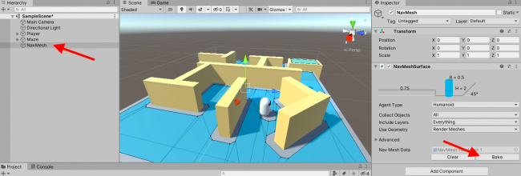
Navigation Meshes
Generating the NavMesh
First, create an empty GameObject and name it NavMesh. The navigation mesh will be generated from and attached to this object. Now, add a NavMeshSurface component to this object. In the Inspector, there are now a bunch of navigation settings, as well as a couple of buttons for managing the mesh generation.
That’s it — you’re ready to create your first mesh! Click Bake, and Unity generates a navigation mesh using the default settings.

Slide 10
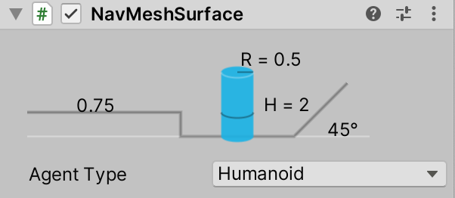
Navigation Meshes
NavMeshSurface first decides which way is up, using its own GameObject’s rotation. It then identifies the surfaces in the scene facing that direction. (In this case, they’re all flat, but NavMeshSurface also works with terrain and other irregular meshes.)
The NavMesh system then must determine what parts of each surface are walkable. Game characters come in all shapes and sizes. The areas that are walkable by a little cat character, for example, would be different from those walkable by a human or a giant robot. This is where the diagram at the top of NavMeshSurface comes in.

Slide 11
Navigation Meshes
The diagram illustrates the properties of the particular kind of agent that will walk on this mesh, such as its radius and height. (You can access these settings in the Agent Type dropdown if you like, but they are not needed for this tutorial.)
The NavMesh system uses these settings to identify where this agent could go. When the system finds an area that is flat, wide and tall enough for this kind of agent, it marks that area as walkable. Then, it generates a flat navigation mesh — the blue areas that just appeared in the scene.
Now that you’ve baked a mesh, it’s time to look more closely at the result. The default settings work pretty well, but there are always things to tweak.

Slide 12
Navigation Meshes
First of all, there’s a hole in the mesh surrounding the player. By default, everything in the scene is considered a potential obstacle to navigate around. You need to explicitly tell NavMeshSurface not to include the player as an obstacle.
NavMeshSurface has a dropdown menu called Include Layers. If you de-select a layer in that dropdown, the mesh generation system ignores the objects on that layer. Follow these steps to put the player on a new layer and then exclude that layer from the mesh:

Slide 13
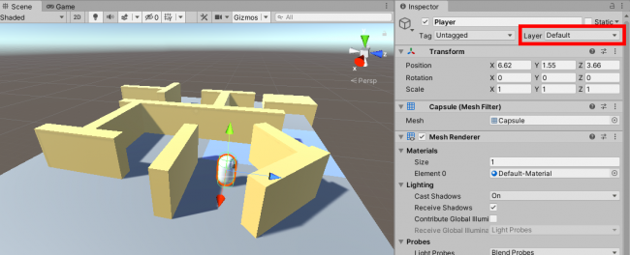
Navigation Meshes
Select the Player GameObject in the Hierarchy.
In the Layer dropdown, select Add Layer.
In the layer management view that appears, type the name Player in the first available row.
Select the player again. Using the Layer dropdown, change its layer to the newly created Player layer. (For an additional challenge, say “player layer” to yourself five times fast.)
A popup appears, asking whether to assign child objects to that layer as well. Choose Yes, change children.
Select NavMesh.
In the Inspector, open the Include Layers dropdown and click Player to de-select it.

Slide 14
Navigation Meshes
Removing an Object from the NavMesh
But there’s another issue. With NavMesh still selected, look at the large corner block. The blue square on top means the navigation system sees it as part of the floor — that is to say, a surface that can be part of a valid path. The player should be able to walk only on the floor, not on top of the walls! But you can’t ignore that block as you did with the player. It still needs to be an obstacle so that NavMesh won’t generate paths through it.
Luckily, you can handle this with another component, called NavMeshModifier. Here are the steps to set it up:

Slide 15
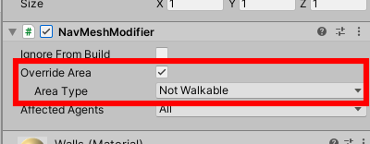
Navigation Meshes
Look in the children of Maze and select Corner.
Add a NavMeshModifier component.
On the component, click to enable Override Area.
Change Area Type to Not Walkable.
Override Area setting in NavMeshModifier component
Now, Unity understands that Corner is an obstacle rather than a walkable surface. Click NavMesh and bake the navigation mesh again

